Slide 1
Capstone Project
Finding the best location in Toronto to open a Chinese food market
Qian Li
July 29, 2020

Slide 2
Agenda
Part 1: Intro/Business problem
Part 2: Data and Methodology
Part 3: Finding areas most populated by Chinese immigrants
Part 4: Decide on area that is least competitive
Part 5: Decide on area with lightest leasing cost
Part 6: Modelling and Testing
Part 7: Result
Part 8: Discussion
Part 9: Conclusion

Slide 3
Part 1: Intro/Business problem
Mr. Chen would like to open a supermarket targeting Chinese immigrants.
His requirements for the ideal place are:
1. large Chinese population;
2. few competitors;
3. reasonable rent.

Slide 4
Part 2: Data and Methodology
Data Sources: Toronto public data portal, Foursquare and CBRE.
The whole research will be carried out in 4 main steps:
1. Use Toronto data to target the main candidate regions (Pandas and Matplotlib)
2. Use data from Foursquare and decide on the number of competitors and population coverage per competitor (Folium)

Slide 5
Part 2: Data and Methodology
Use CBRE to see the leasing costs
Crunch relevant data into one data frame, and import reference data, which is used to do supervised machine learning in deciding which region has the best chance for success.

Slide 6
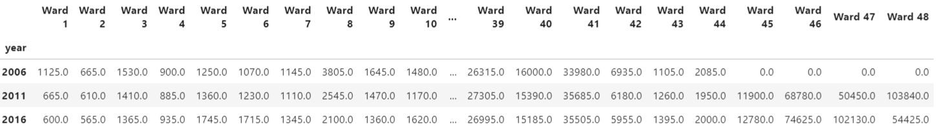
Part 3: Finding areas most populated by Chinese immigrants
Resource: public data portal for Toronto(https://www.toronto.ca/city-government/data-research-maps/neighbourhoods-communities/neighbourhood-profiles/)
There are 48 wards in Toronto. Data for Chinese population in each ward of 3 years are found: 2006, 2011, and 2016.

Slide 7
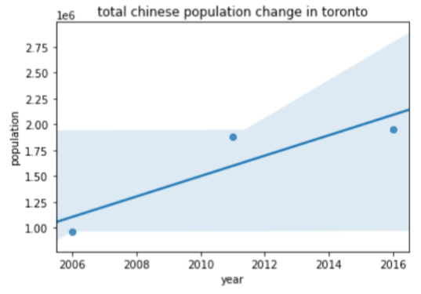
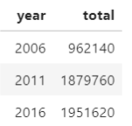
Part 3: Finding areas most populated by Chinese immigrants
A snapshot of total Chinese population change in whole Toronto:

Slide 8
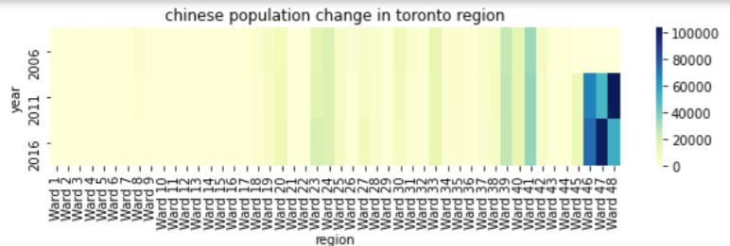
Part 3: Finding areas most populated by Chinese immigrants
Which region has the largest Chinese population? Wards 46,47,48.

Slide 9
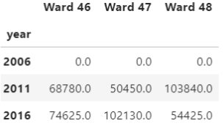
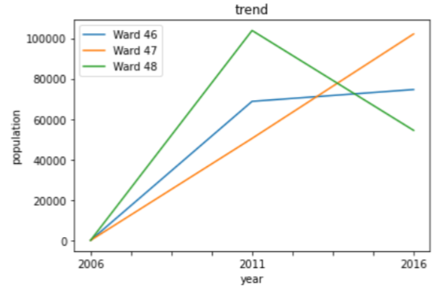
Part 3: Finding areas most populated by Chinese immigrants
Chinese population trend in these 3 wards:
Data for 2006 is missing but it doesn’t matter a lot for our analysis.
When referring back to the original data from Toronto portal, we know that Ward 46 is North York, Ward 47 is East York and Ward 48 is Scarborough.

Slide 10
Part 4: Decide on area that is least competitive
Using the geographical info of those wards, we put it into Foursquare and explore those areas.
We use geolocator to decide the ward centers’ latitude and longitude.
North York geo location:
43.7543263 -79.44911696639593
East York geo location:
43.6685545 -79.3072382
Scarborough geo location:
43.773077 -79.257774

Slide 11
Part 4: Decide on area that is least competitive
Explore competitor markets around the areas: When doing research on Foursquare, the searching keyword is set to be “Asian Market” because all Asian markets are considered as competitors.
We got lists of competitors and their locations on map as follow:

Slide 12
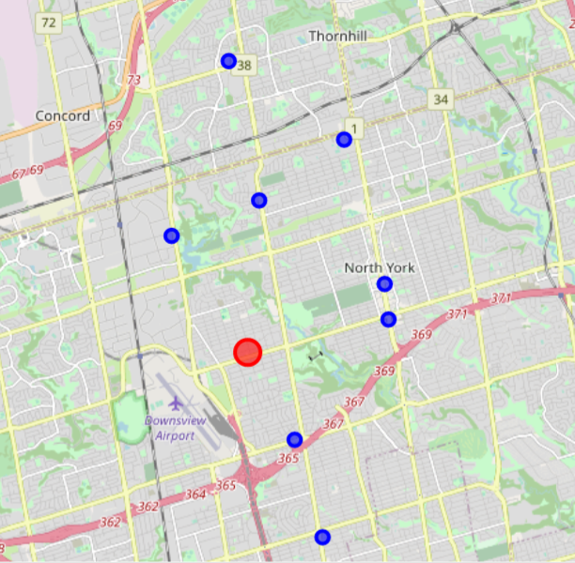
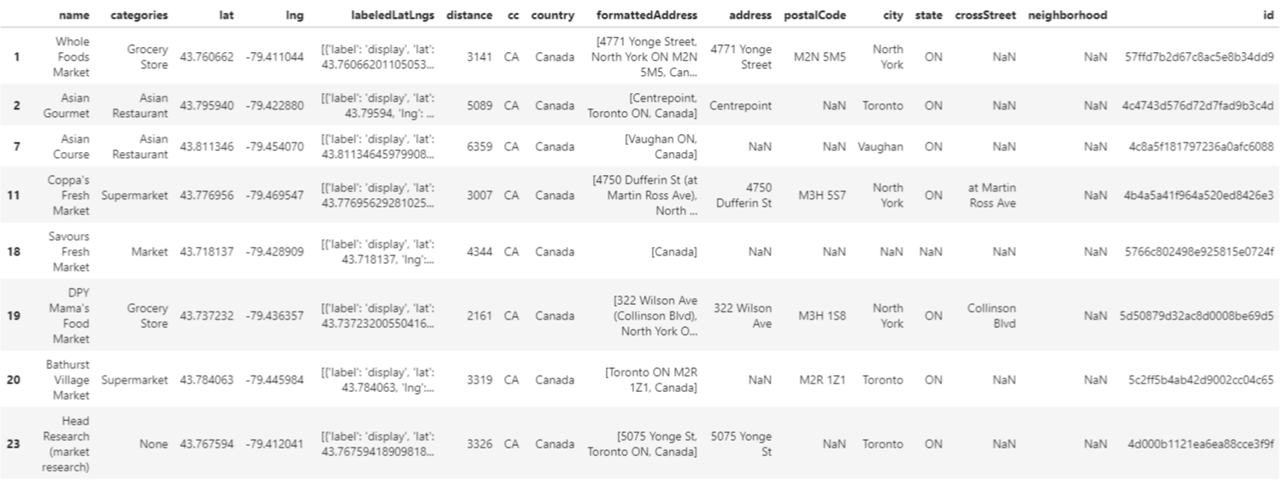
Part 4: Decide on area that is least competitive
North York

Slide 13
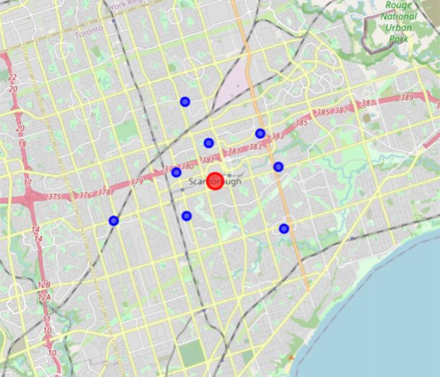
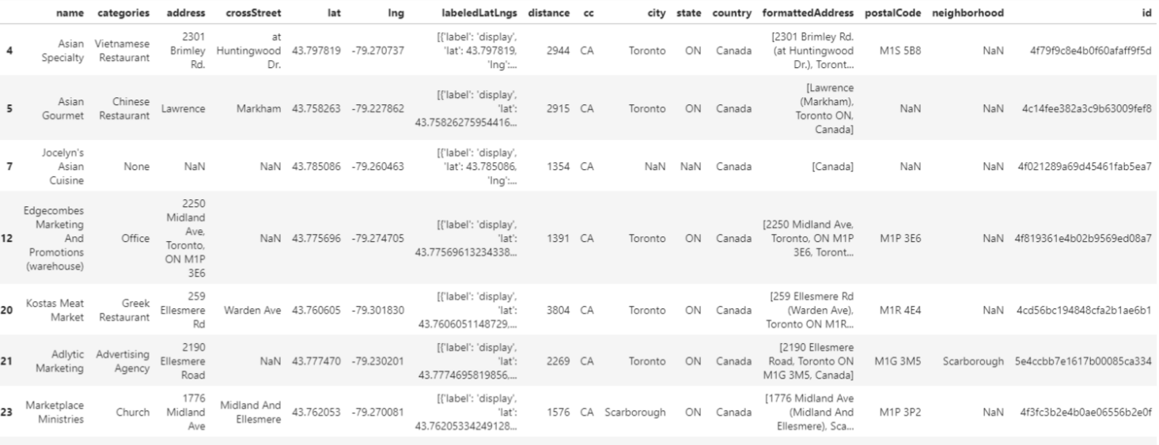
Part 4: Decide on area that is least competitive
Scarborough

Slide 14
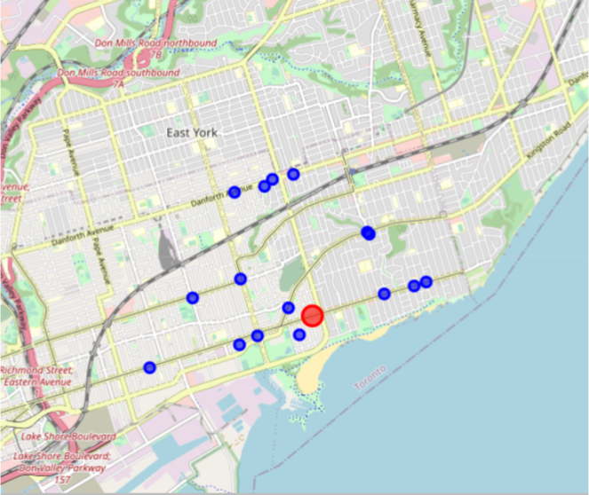
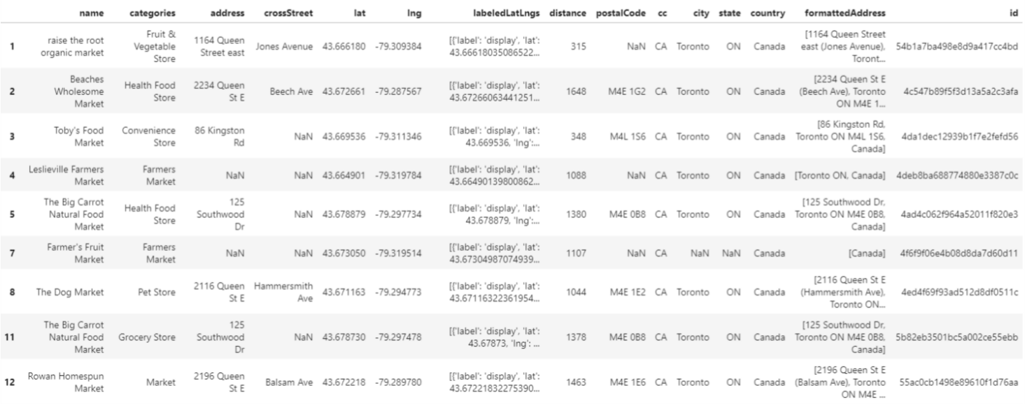
Part 4: Decide on area that is least competitive
East York:

Slide 15
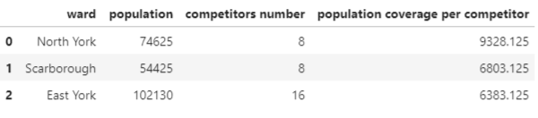
Part 4: Decide on area that is least competitive
North York has 8 competitors, Scarborough has 8, and East York has 16.
The competitiveness will need to factor in the population in those areas.
divide the population by competitor number to see how large is the population each competitor cover, which we will name it as population coverage in the following part.
North York having the biggest population coverage.

Slide 16
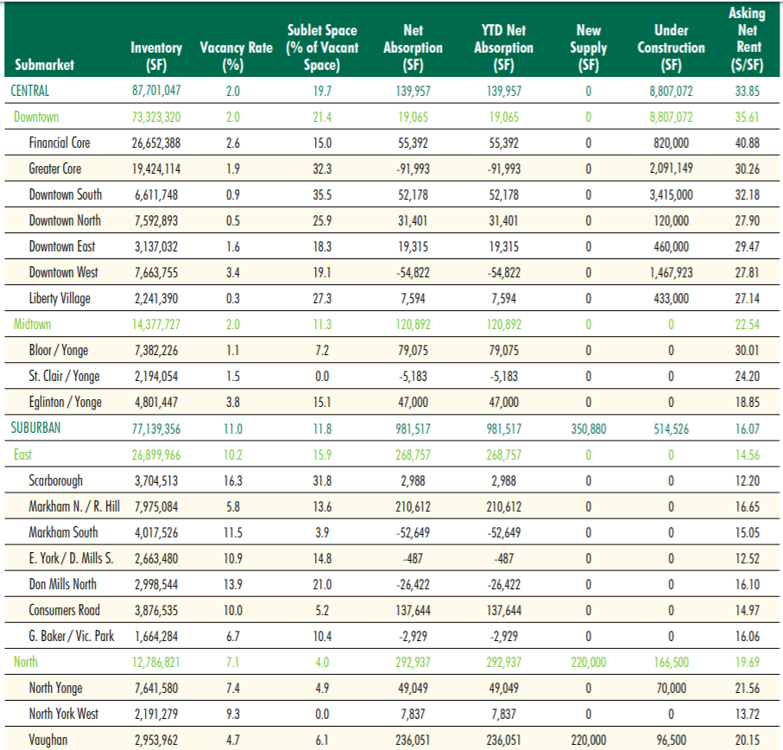
Part 5: Decide on area with lightest leasing cost
Apart from the population coverage, Mr. Chen also wants to know the leasing cost, and uses both factors to determine the location choice. Here it is:
(https://www.cbre.ca/en/research-and-reports/Toronto-Office-MarketView-Q1-2020)

Slide 17
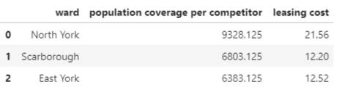
Part 5: Decide on area with lightest leasing cost
The corresponding leasing price for the 3 wards are included in the following chart with the population coverage information:

Slide 18
Part 6: Modelling and Testing
The final answer we want to get is whether the business will be successful or not, by analyzing the information we got.
This is very similar to a prediction model in machine learning. Hence classification will be the method we use. We will try to use data features to predict the business in each ward will be successful (labelled as Y) or not (labelled as N).
We found some historical data for supermarkets running in Toronto areas, which can be used to train the machine learning model. We use train-split-test to get the best model and then apply the model to real data for prediction.

Slide 19
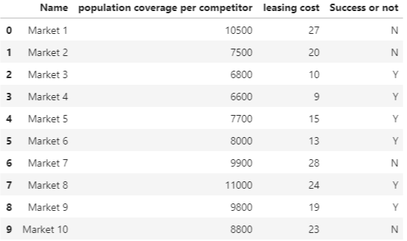
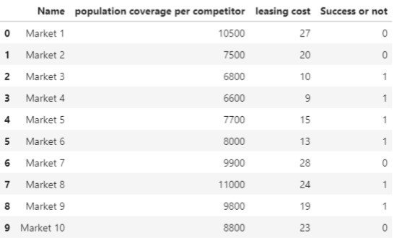
Part 6: Modelling and Testing
Here is the data for modelling. For the convenience of modelling, we change the Y/N values into 1/0 as follow:

Slide 20
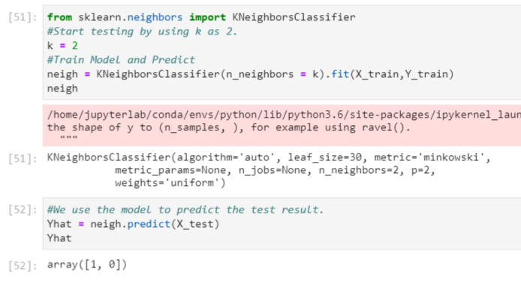
Part 6: Modelling and Testing
We use 80% of the data to train the model and 20% to test it. We process the “competitor” and “leasing cost” into numpy array as X, “success or not” as Y. KNN will be the method for use. We then use accuracy metrics to test how accurate it is. Setting K=2, we got the following result:
Yhat is 1 and 0, by referring back to original data, the prediction is correct. Accuracy for train set is 0.875 and test set 0.5.

Slide 21
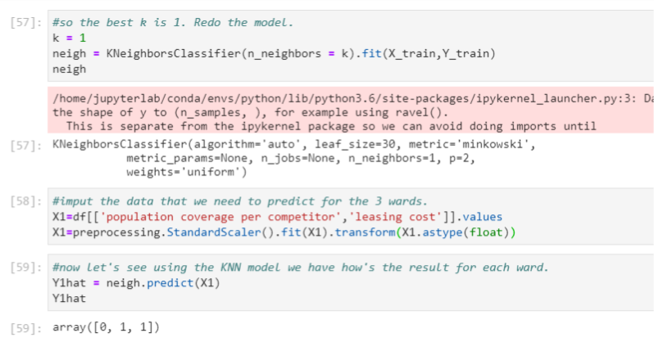
Part 6: Modelling and Testing
The result looks nice, but we want to find the best model, so we try to test every K value possible, from 1 to 9. The calculation tells us that the best K is 1, when train set accuracy is 1 and test set 0.5. Then we redo the model with k=1 and apply the model to actual data of the 3 shortlisted wards.
It gives a final result as an array [0,1,1] for the 3 wards.

Slide 22
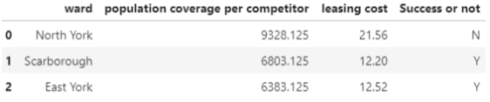
Part 7: Result
We transform that Boolean values back into Y/N values and integrate them into the data frame:
The analysis for the 3 wards has a preliminary conclusion:
To open a Chinese market in the 3 wards, North York will be not successful, Scarborough and East York will be successful.

Slide 23
Part 8: Discussion
Unfortunately, North York fails the test.
For Scarborough and East York:
Scarborough slightly wins over East York in population coverage (6803 over 6383, the difference is about 5%)
Scarborough wins by 0.32 CAD per square foot (12.20 compared with 12.52 in East York, the difference is about 2%).
However in population trend, Scarborough is much less favorable to East York.

Slide 24
Part 8: Discussion
Now recall the following plot:
Just to remind that Ward 47 is East York and Ward 48 is Scarborough. We can see that the Chinese population in Scarborough is decreasing sharply by 47.5%! While that in East York is growing by 102%! We can conclude that Chinese immigrants are leaving Scarborough and more like to settle down in East York.

Slide 25
Part 8: Discussion
Business needs to look in to future, population trend means future, which is very important for business.
Population is the most important feature we need to consider for potential market. Besides, when comparing with the population trend change, the difference of leasing costs and population coverage look small. Therefore, even though East York is slightly less advantageous to Scarborough in leasing cost and population coverage, the former’s population trend benefit is much better than the latter. East York is a better choice.

Slide 26
Part 9: conclusion
Weighing in the population trend, population coverage and leasing cost, the final winner is:
East York!!!

